Slide 1
Citizen Science with IOTA
July 20, 2021

Slide 2
An occultation is one of the most profoundly amazing sights that the amateur astronomer can ever witness. Occultations, like eclipses, involve the passage of one celestial object in front of another, an opportunity to study one or both objects.

Slide 3
IOTA Members
Provide predictions for occultations of stars by asteroids, planets, and the Moon
Encourage and facilitate the observation and measurement of occultations and eclipses, coordinate observing efforts among members and with other observing campaigns
Provide software and information on observing equipment and techniques
Report and publish observations
Teach others observing techniques, software use, data evaluation
Provide equipment and software available nowhere else
All of this is Citizen Science!

Slide 4
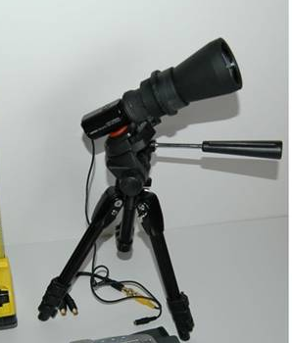
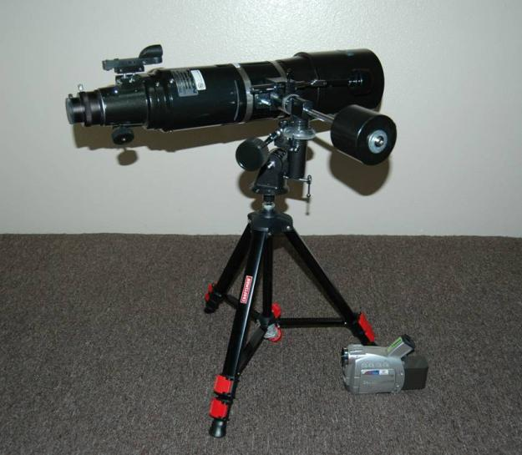
Giant aperture not required for observing asteroid occultations -
You Only Need To See The Star - Not the Asteroid!
120mm objective to magnitude 12.5
50mm objective to magnitude 9.0

Slide 5
Modest Observing Equipment is Sufficient for Good Science
Tools of the scientist are the same as the tools of the amateur: telescopes, cameras, star charts.
Good software for observers is freely available
Meaningful observations can be made with inexpensive equipment.
In occultation observing, the telescope and camera are important, but where you put it is equally important. Many amateurs are in the fortunate circumstance of being able to go almost anywhere in the world.

Slide 6
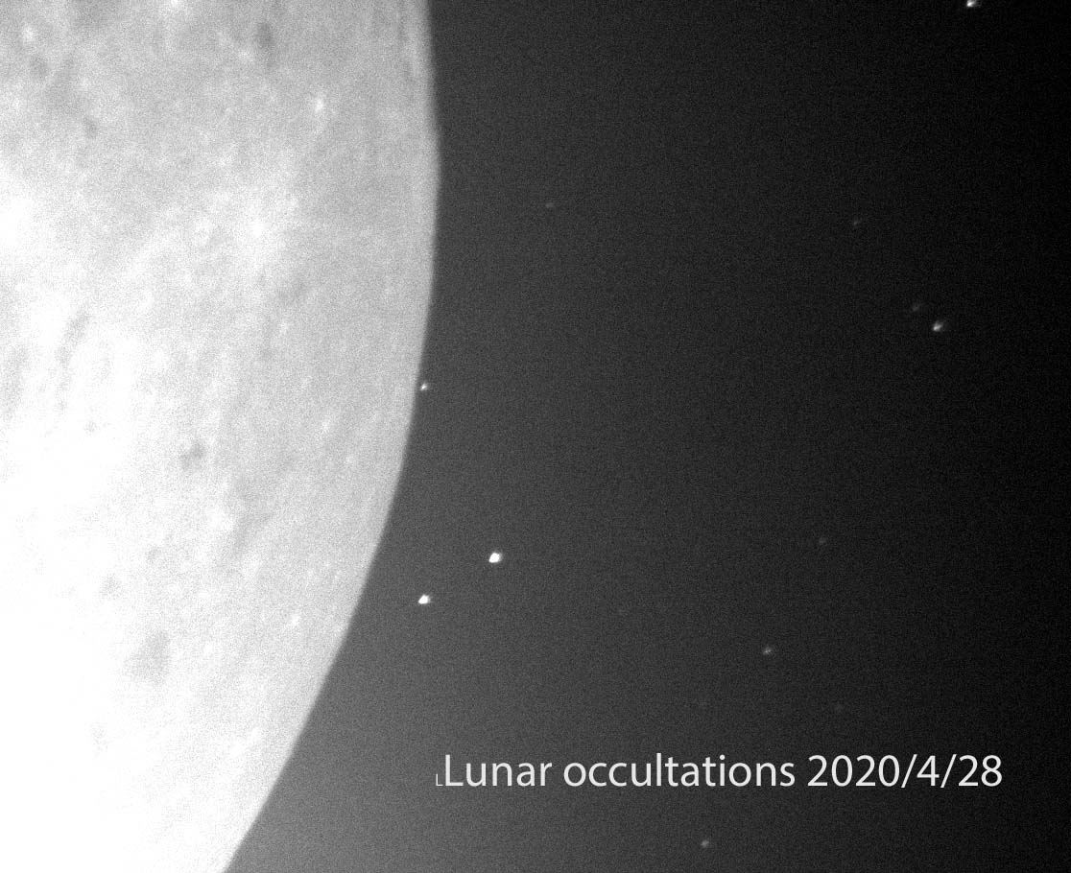
What is an Occultation
An occultation in astronomy is the passage of a celestial object between the observer and another celestial object
IOTA observes occultations
By the Moon of the Sun (eclipses), stars, planets
By asteroids of stars
By planets of stars

Slide 7
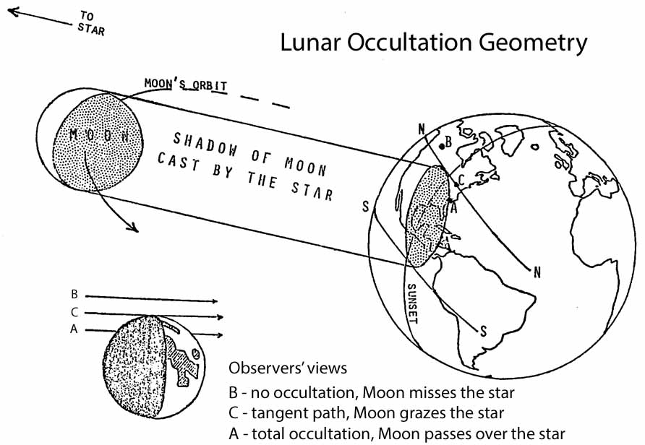

Slide 8
Occultations of Stars by the Moon
Historically observed for information on the lunar orbit
Now observed for information on the star
Double star detection and confirmation
IOTA predictions alert users to double stars and suspected double stars
Sizes can be determined from high time resolution recording of the diffraction pattern as the star disappears/reappears.
This requires more specialized equipment than most observers can access
Lunar occultations provide observers with opportunity to practice observing skills and test equipment as well as proficiency in event prediction and data reduction

Slide 9
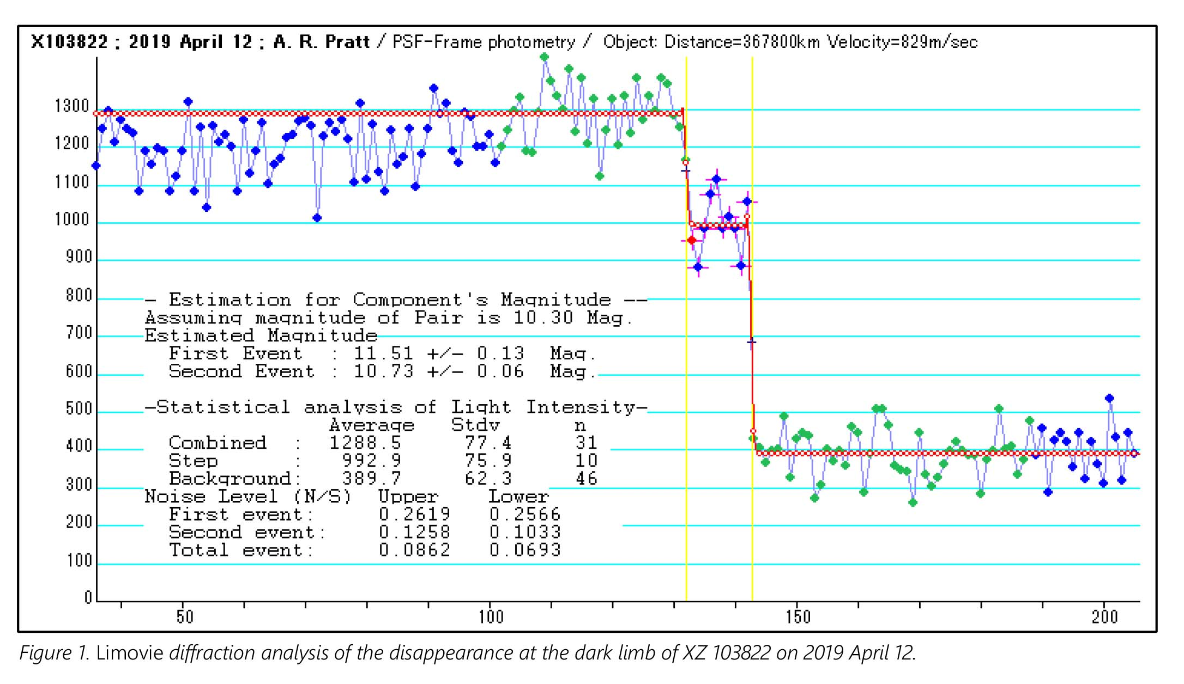
Double Star Detected from an Occultation
Published in JOA 2020_2

Slide 10
Grazing Occultations
Fun to observe; during grazes the Moon’s motion is clearly evident as a star skims by the edge, visible when it crosses a valley, disappearing when it is behind a mountain as seen by the observer
Only visible from narrow bands on the Earth’s surface
The event duration is short, at most a few moments
Graze circumstances of where, when, what depend on alignments of the observer, lunar limb, and star
Historically an important source for lunar limb topography refinement and lunar position
Today primarily to provide opportunities for teaching observing skills.
Occasionally, a star is found to be binary.

Slide 11
Aldebaran Graze
July 29, 2016
This was the view of the 23% sunlit waning crescent Moon as seen from Oklahoma, virtually the same for other locations that were along the graze path across North America. The orange star appeared to approach the Moon from the sunlit side, passing very close to the northern cusp. After the star passed over the bright cusp, it was visible to the naked eye, except where where strong twilight or daylight interfered, as it moved onto the dark side during the graze. The dark side of the Moon was illuminated by Earthshine, and the darker features could be seen with binoculars.
Aldebaran

Slide 12
Observing Occultations by Asteroids
To obtain precise asteroid position locations, used to improve their orbits
This is the most common use
To define outlines of asteroids from multiple tracks across them
A good definition requires many tracks, which generally means many observers
To detect double stars
Or to confirm suspected duplicity
To detect asteroid moons
Very infrequently but always exciting

Slide 13
Terp, Limovie,
OW demo

Slide 14
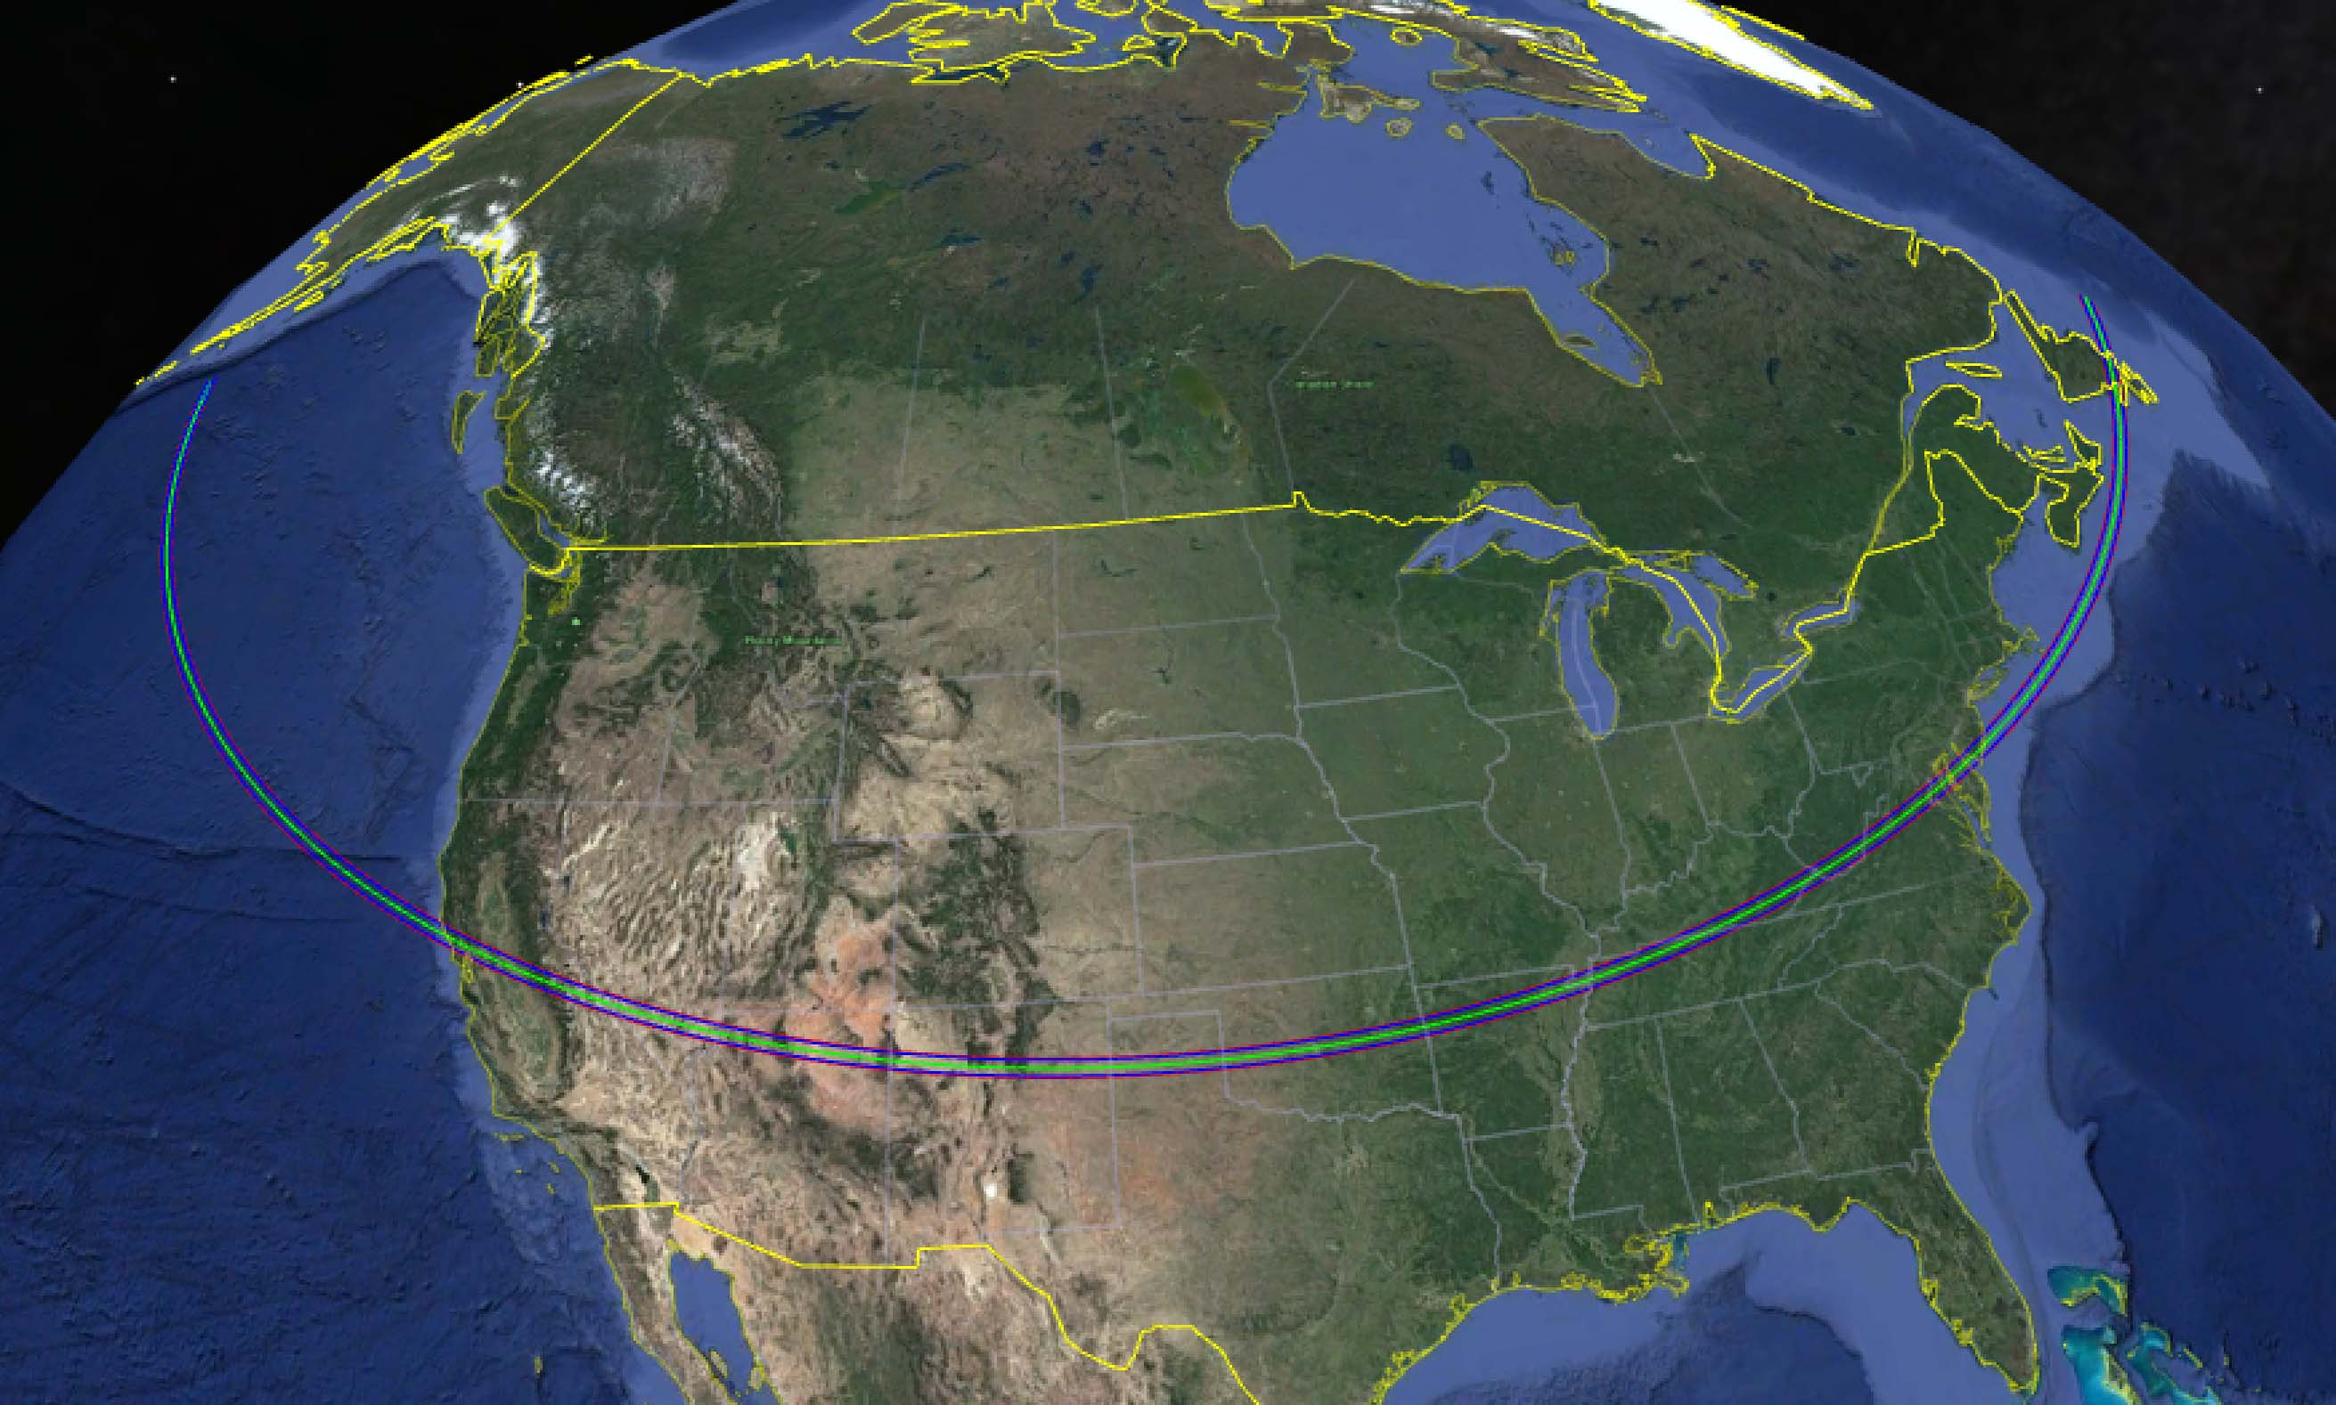
Occultations of Stars by Asteroids
Asteroid occultation paths are narrow, as the asteroids are small, but the concept is the same as occultations by the Moon: The narrow path shown here is the path of the shadow of the asteroid cast by the star.
Predicted path for June 30, 2021 occultation of UCAC4 – 323-113857 by (4337) Arecibo

Slide 15
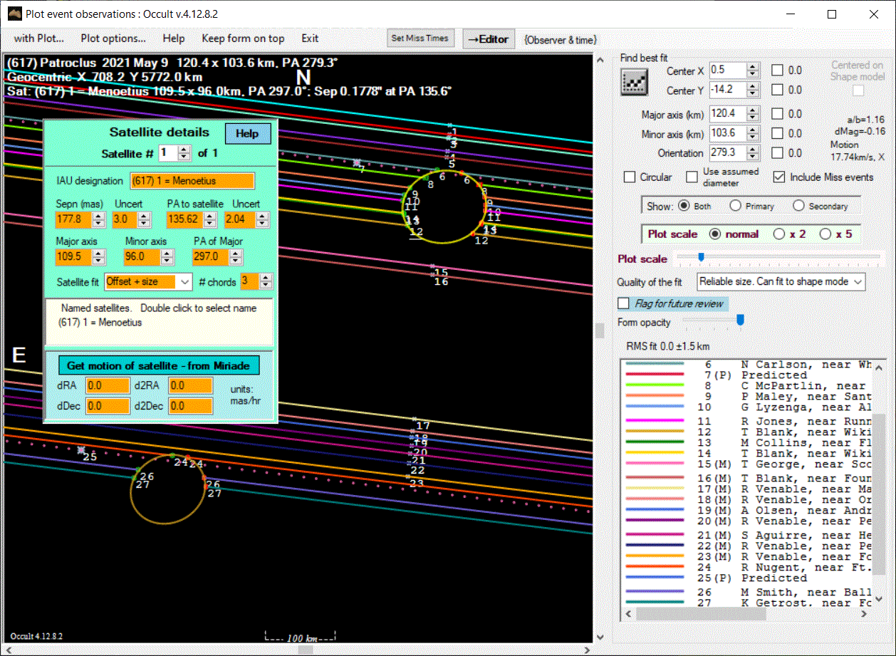
Occultation by (617) Patriclus and its moon Meneotus observed 9 May 2021

Slide 16
Recent Notable Successes
Arecibo satellite detection and confirmation
Apophis – considered potential hazard
Near Earth asteroid (NEOs) observations

Slide 17
(4337)Arecibo Satellite
Discovery:
David Gault and Peter Nosworthy in Australia each recorded clear secondary events on 2021 May 19 from an occultation of UCAC4 323-126197.
Confirmation:
Richard Nothenius and Kirk Bender in California each recorded clear secondary events on 2021 June 9 from an occultation of UCAC4 322-116848.
Satellite and Asteroid Diameters:
(4337) Arecibo: 24.3 +/- 0.6 km
Satellite: 13.0 +/- 1.5 km (assuming a circular object)
More observations are needed to determine the satellite orbit
An announcement of the satellite made by the Central Bureau for Astronomical Telegrams
More publications on this interesting asteroid are expected

Slide 18
Recent Occultations by Near Earth Asteroids (NEAs)
NEAs are important
Earth impact concerns
Easier target for satellite missions
Draws significant attention from space agencies, scientists, and public
More difficult to predict and observe
Small size
More easily perturbed by smaller non-gravitational effects
Occultation durations short
Only observable from Earth during a fraction of their orbits
Occultations observed by NEAs (3200) Phaethon, (99942) Apophis, (4337) Arecibo

Slide 19
(99942) Apophis
Was considered potentially hazardous to Earth
Successful occultation observing campaign reduced the hazard potential to extremely unlikely although it will pass very close in 2029
Reports of the Apophis observation campaign published in the 7th Planetary Defense Conference - PDC 2021 26-30 April 2021
Observable January – September of this year
One event predicted for Sept 27, 2021 which will be very difficult, with a maximum occultation duration of 0.02sec

Slide 20
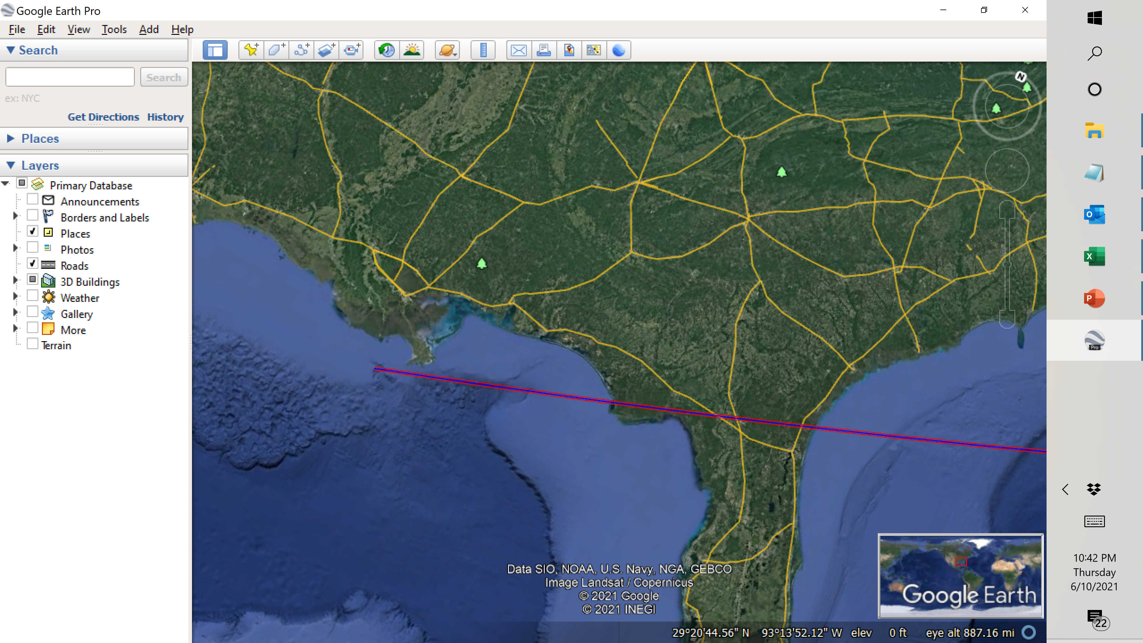
Apophis 9/27/21. A very difficult event, duration 0.02sec, 9 deg elevation.

Slide 21
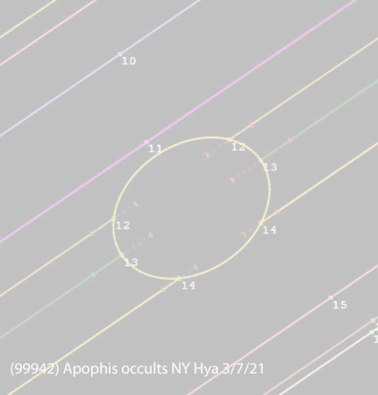
Monitoring the potentially hazardous asteroid Apophis as it passed near Earth
Very successful observations led to conclusion that Apophis is not a risk!
Occultations by Apophis recorded 4/4/2021,
Updates posted on
occultations.org/citizen science with IOTA

Slide 22
Upcoming Events for 2021 August - December
Good lunar occultations
(3200) Phaethon occultations
(4337) Arecibo occultations
IOTA normally plans for one or two occultation campaigns a year, focusing on asteroidal occultations of brighter stars to have a larger number of participants. COVID-19 concerns have precluded that for 2021. We hope to resume occultation campaigns in 2022.

Slide 23
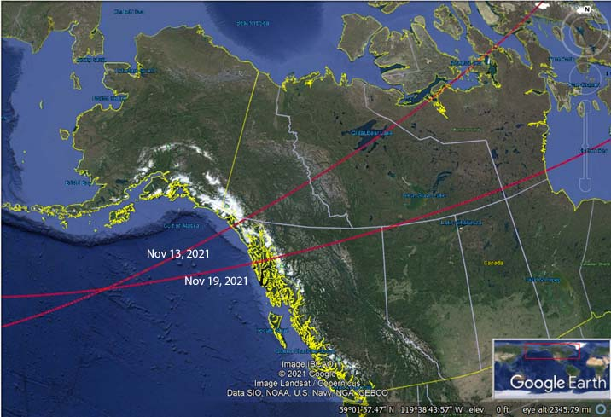
(3200) Phaethon Events
Two occultations by Phaethon with some good parameters but of very short (0.2 sec) duration.

Slide 24
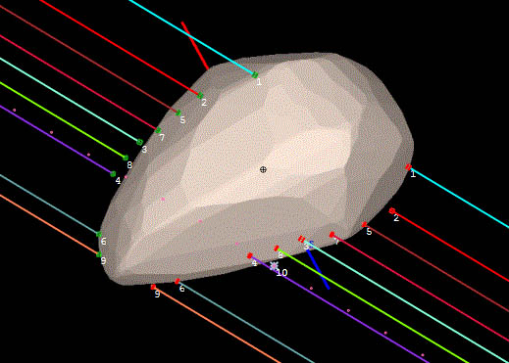
Occultation Observers also
Improved knowledge of the shape and sizes of asteroids
(441) Bathilde occultation 2020-11-10
And
Determined corrections to ephemeris errors and assessed star position errors
Discovered double stars
Discovered satellites of asteroids, rarely but always exciting

Slide 25
Equipment Needed for Occultation Observing
If you are unsure if you really want to observe occultations, use what you already own to watch one, even if you can’t record or time the event.
Telescope
Wide field is better than narrow
GOTO or driven nice but not necessary
Large aperture nice but not necessary
Precise time source
GPS based preferred
Data and time recording to better than 0.1sec (100ms)
GPS time-tagged data preferred
Many individuals already own suitable telescopes and can easily support data recording with a personal laptop or tablet computer.

Slide 26
Equipment for Observing
Visual observation
Used by generations of observers with various means of timing the event but with today’s increased precision requirements no longer recommended
Fine for those who just want to see what an occultation looks like
Video recording
Video camera on a telescope, data captured by a computer program, time and position from GPS data insertion
Video camera on a telescope, data captured by a DVR, time and position from GPS data insertion
Video camcorder with a long lens, time and position provided in multiple different ways depending on the circumstances
Digital camera
Astronomy digital camera on a telescope, data captured to a computer
Some cameras include GPS, others need a means of data annotation

Slide 27
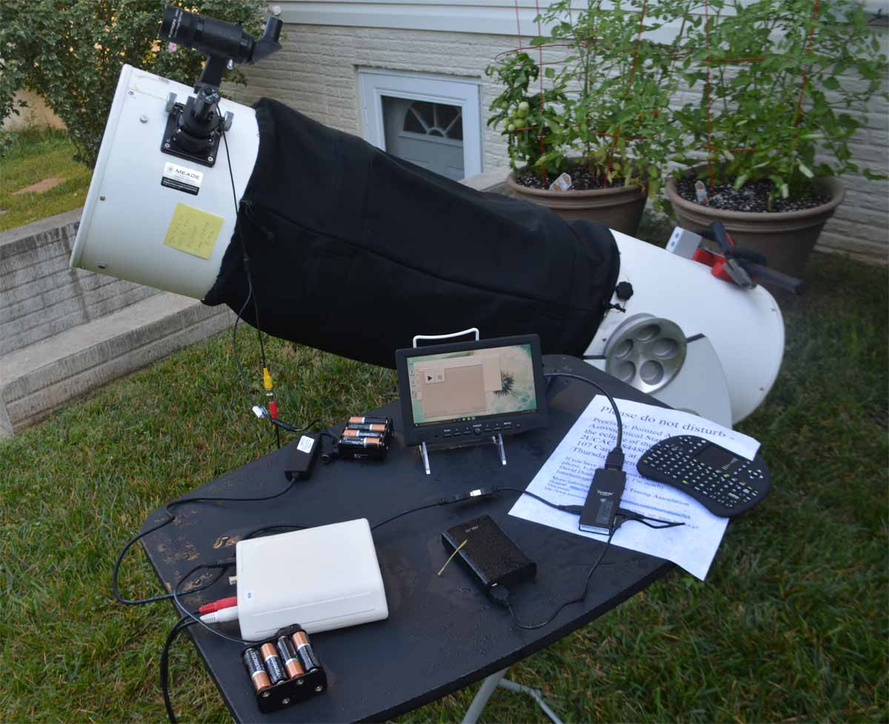
Occultation Observing Equipment
Example observing set-up with a small video camera on the telescope, a very small Windows computer, and a IOTA VTI for GPS data time and position.

Slide 28
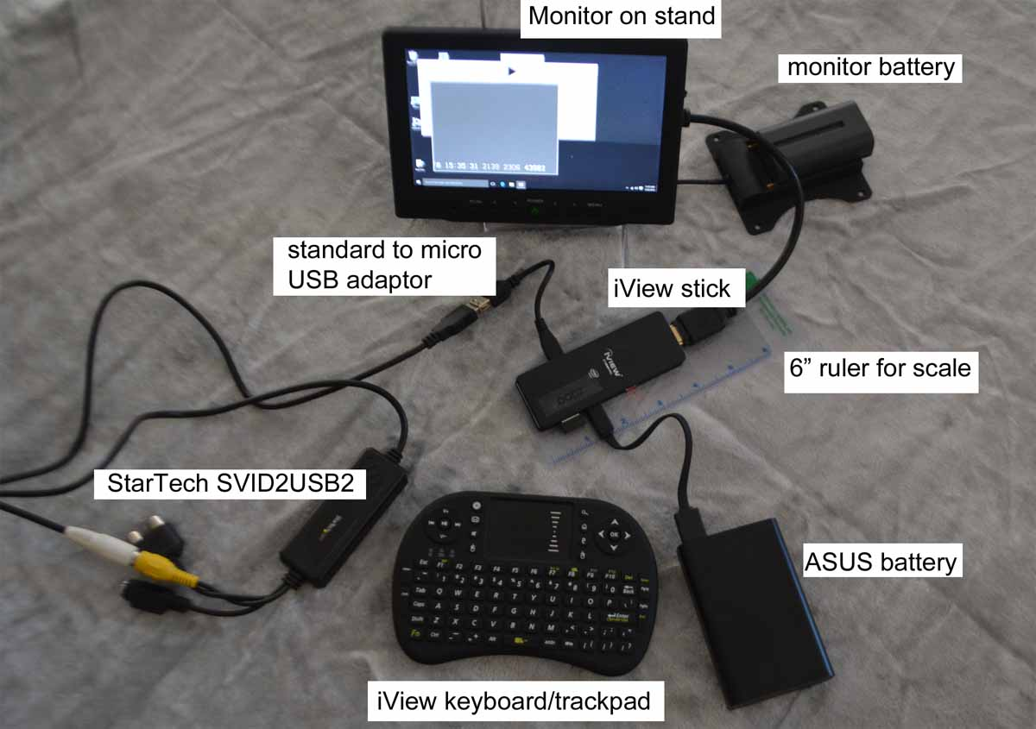
Occ2 Recording System
Data capture to a very small “stick” Windows computer.
For unattended observation, the monitor and keyboard are removed leaving something that does not resemble a computer.
Labeled picture TBS

Slide 29
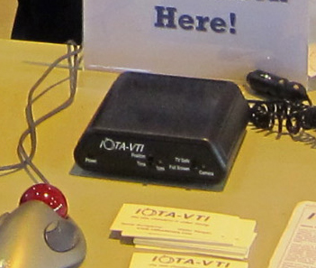
GPS Video – IOTA VTI Provides accurate (msec) timestamps on every video frame

Slide 30
Cameras Available in North America
Analog Video
Digital Video
Watec 910 HX
More expensive
Order from www.avsupply.com
RunCam Night Eagle Astro II
Very inexpensive
Available on occultations.org
Malincam
Expensive ($800 and higher)
QHY174 GPS
More expensive (>$1000)
Best with SharpCap for occultation data capture
Digital camera, data captured directed on a Windows computer with SharpCap or other software

Slide 31
Complete Occultation Recording Kit
IOTA offers a complete “ready-to-observe” kit for precision recording. Pricing and ordering information are available at https://occultations.org/observing/recommended-equipment/iota-vti/
Various other options besides the full kit are also available, see https://occultations.org/night-eagle-2-pro-astro-edition-ordering-page/
A flyer is available that has further details.

Slide 32
Recording Analog Video
All of the software in discussed in this presentation are for Windows OS
Analog video camera data digitized with the StarTech SVID2USB232
Computers can be any Windows 10
Recommend use of small, inexpensive computers or tablets for remote use
Most, but not all, of the software will run on Win 7 and 8 OS as well
More information on how to set up a computer for occultation use at occultations.org
Portable DVRs are also an option for data capture, but they are becoming less available. If you do not have one, the advice is to use a computer instead
Analog video data time stamped by feeding the data through the IOTA VTI on its way to the digitizer and then capture by a computer

Slide 33
Video Capture Software
IOTA Video Capture – analog video
Simple, easy to use, does recording and scheduling for automatic capture
Very complete manual available
Limovie - analog video
More complex, has multiple functions
Limited user help available
Virtual Dub – analog video
More complex, has multiple functions
SharpCap – analog and digital video
Links for accessing these programs at the end of the presentation

Slide 34
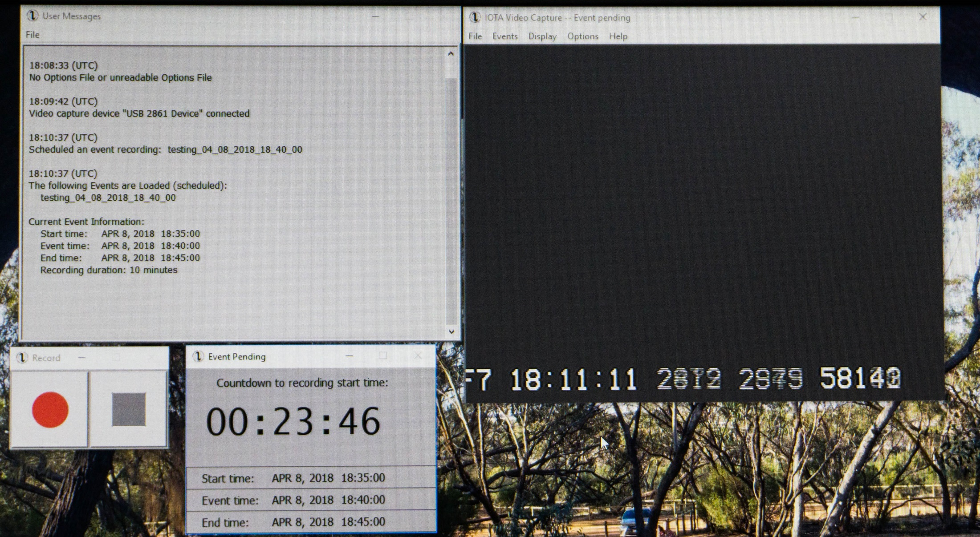
IOTA Video Capture

Slide 35
Occult 4 – Occultation Prediction and Reduction
A centerpiece of modern occultation science
Prediction and reduction of lunar occultations
Observers should learn to generate their own lunar occultation predictions and their own data reductions
Prediction and reduction of asteroidal occultations
Written and maintained by David Herald of Australia
A link to access the software is at the end of the presentation.

Slide 36
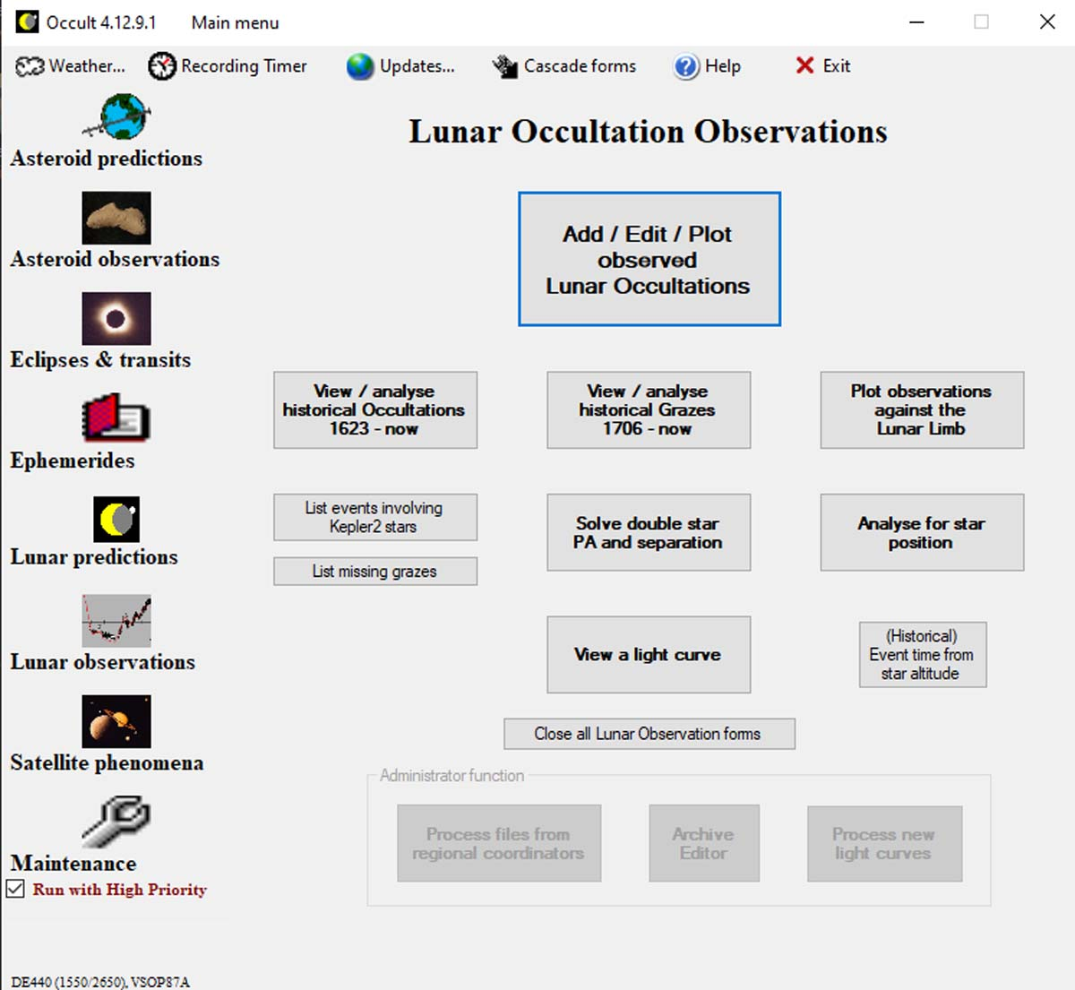
Occult 4 Main Menu
Occult is a key part of the occultation prediction and data reduction process. New users can start with Lunar predictions and Lunar observation analysis.

Slide 37
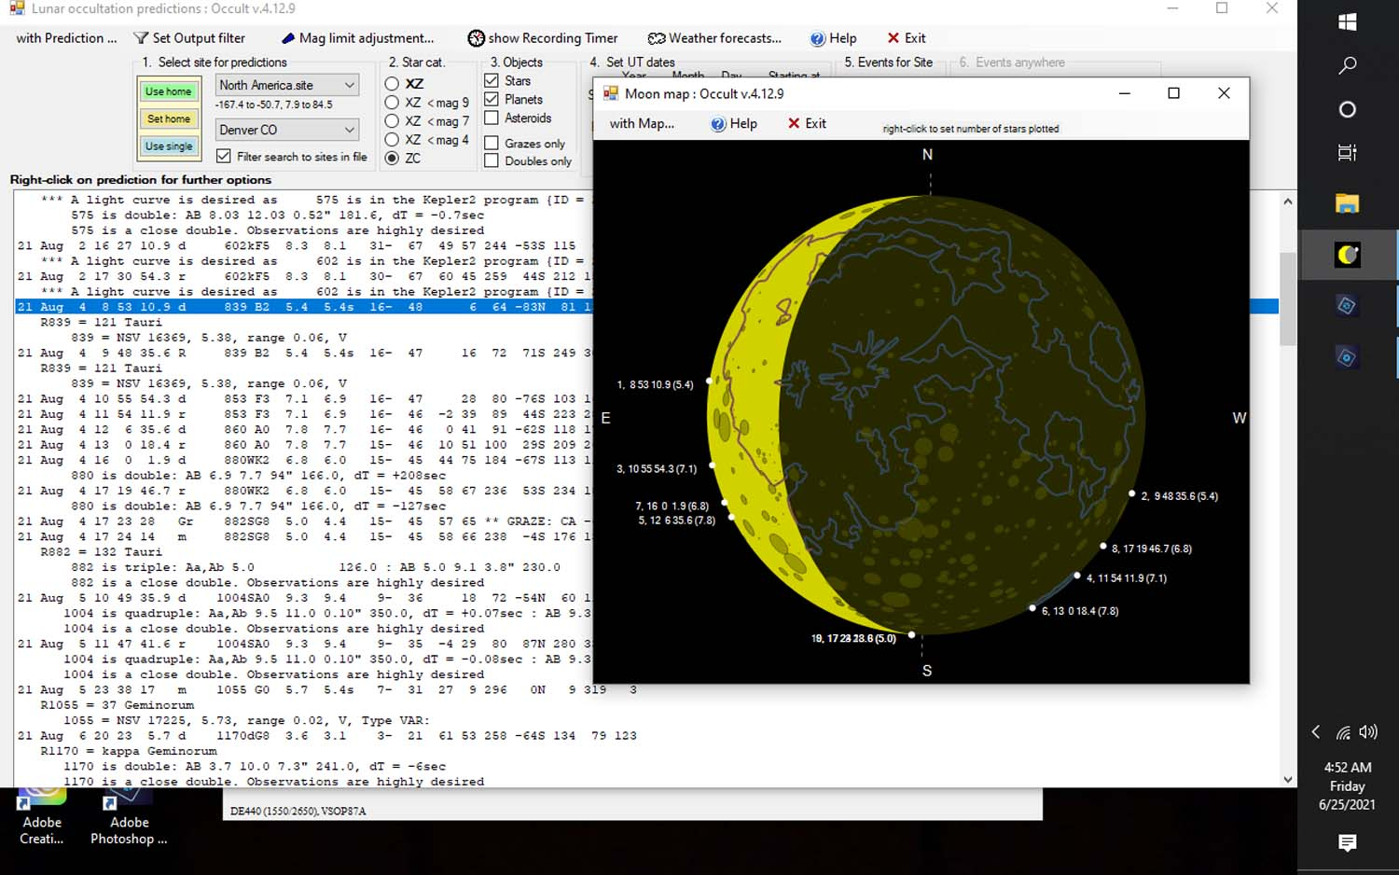
Occult 4 Total Occultation Predictions for August 4, 2021 for Denver

Slide 38
Asteroid, Eclipse, Mutual Gallilean Satellite Events Predictions
Predicting asteroid events is very complex. Most individuals are not expected to generate their own.
Predictions for the main belt asteroids are available from coordinators, distributed via Occultwatcher, the various user groups, newsletters.
Special predictions for asteroids which are mission targets, Kuiper Belt objects, small potentially hazardous Earth-crossing objects are also distributed widely
Solar and lunar eclipse predictions are readily available to the public
All of these are events for which observers are desired, sometimes desperately needed. More observers are always welcomed.

Slide 39
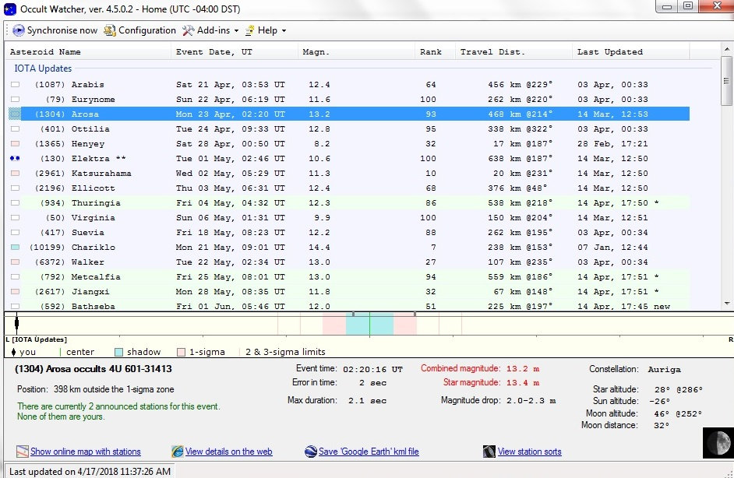
Occult Watcher (for asteroidal & TNO events)
http://www.occultwatcher.net/publish.htm

Slide 40
(56803) Didymos
Small 780m asteroid with an even smaller moon, 160m Dimorphos
Passes close to Earth but not a threat
Considered potentially hazardous
NASA's Double Asteroid Redirection Test (DART) mission, launching 2021, to impact Dimorphos in late September 2022
Multiple occultations predicted for North America in 2022
Star max.
Date mag. dur. Area
2022 May 24 12.7 0.07s s. USA
2022 Jul 24 11.7 0.19s s. Alberta to Georgia, USA
2022 Aug 3 11.5 0.21s San Diego to Brazil
2022 Aug 11 12.4 0.21s s.w. USA to n. Brazil
2022 Aug 23 11.9 0.21s w. Montana to n. Brazil
2022 Sep 3 10.4 0.19s n. Mexico to s. Texas
Occultation observations important to track Didymos and Dimorphos before and after the DART impact.

Slide 41
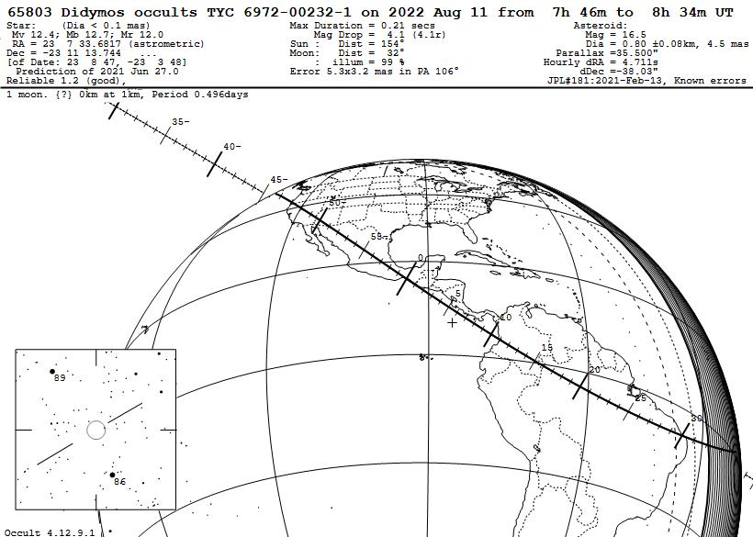
This Didymos occultation is a difficult one to observe. The star is Mv 12.4 and the maximum event duration is 0.21 sec.

Slide 42
Data Evaluation and Analysis Software
Observers are encouraged to do the data analysis of their own asteroid data recordings. Help is available for more challenging situations
Data evaluation and extraction
Target star light level is extracted from analogue or digital video and stored in a spreadsheet (csv file) with time tag information for each video frame or field
Pymovie, limovie, Tangra each can perform this function
Data analysis
The data from the spreadsheet are analyzed and the results summarized for reporting.
Pyote, Rote, OTE each can perform this function. Pyote is the most user friendly
Software access locations give at the end of the presentation

Slide 43
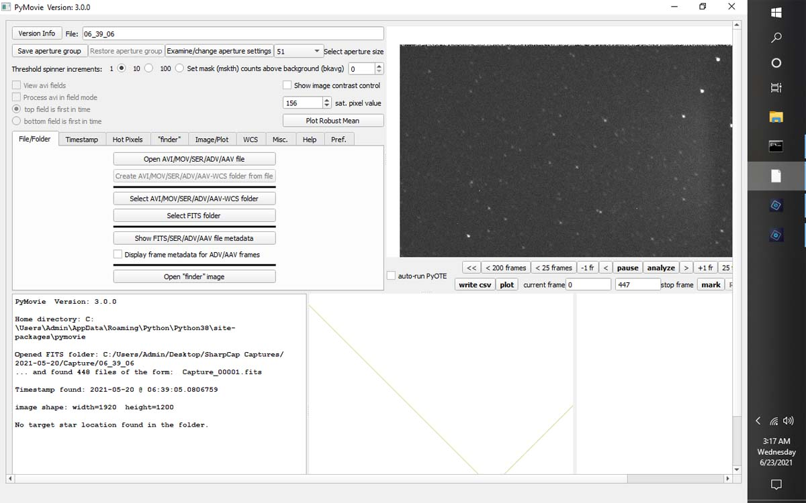
Pymovie – Data Evaluation and Extraction
Analyze analog video AVI files and digital video FITS data to measure changes in stellar apparent brightness over the occultation period.

Slide 44
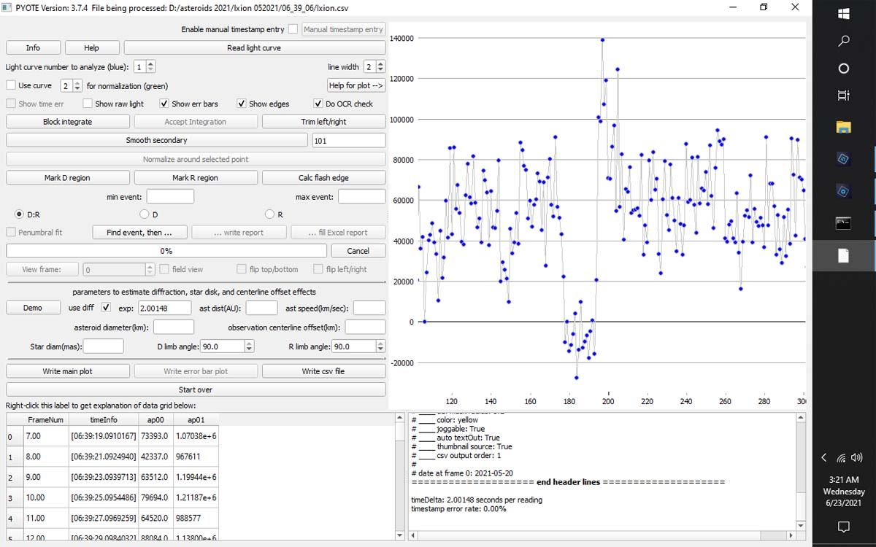
Pyote – Data Analysis
Evaluate spreadsheets of time changes in stellar brightness to determine occultation time and time accurcies

Slide 45
Instruction and Guide Materials
The website occultations.org has observing instructions plus links to more detailed training information
Chasing the Shadow – The IOTA Occultation Observers Manual
Detailed instructions on using OCCULT4 to generate your own predictions are at www.lunar-occultations.com/iota/2021iotapredictions.pdf
The OCCULT4 user guide is at lunar-occultations.com/iota/occult4.htm
Help menus are also available in the software

Slide 46
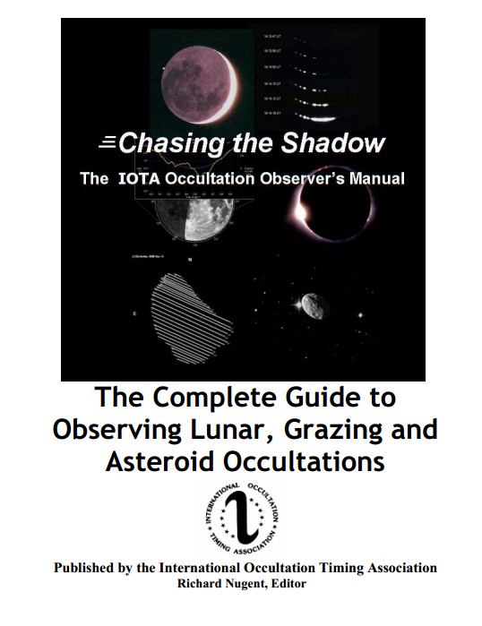
IOTA Observing Manual
Available at IOTA’s main Web site,
http://occultations.org
The observing tab there,
directly
http://occultations.org/observing/
has the latest information about
recommended software and equipment.
Other tabs for joining, for our publications, and meetings (“community”)
Available at
http://occultations.org

Slide 47
Opportunities for Every Observer!
If you have access to a computer, possess a telescope of at least 4-6 inches, know your geodetic position, have a source of precise time, you can observe these rare and critical events.

Slide 48
Cannot observe? Only observe from home? But still want to help? Or want to do more than observing?
Multiple non-observing activities are also part of IOTA
Note that observing experience aids in understanding what is needed
Develop equipment or software for observing
Already have an observatory or funds to obtain one?
Automated observing might be your thing
Other ways to help
Web site maintenance
Outreach
Teach: Observing techniques, data analysis, how to use the software
Just ask!

Slide 49
Web Sites and Resources
https://occultations.org – hosts considerable information and well as links to other sites
Journal for Occultation Astronomy – published jointly by IOTA, IOTA-ES, an RASNZ
Freely available at https://iota-es.de/joafree.html
http://lunar-occultations.com/iota/iotandx.htm - has many links to other sites plus considerable information on occultations and observing

Slide 50
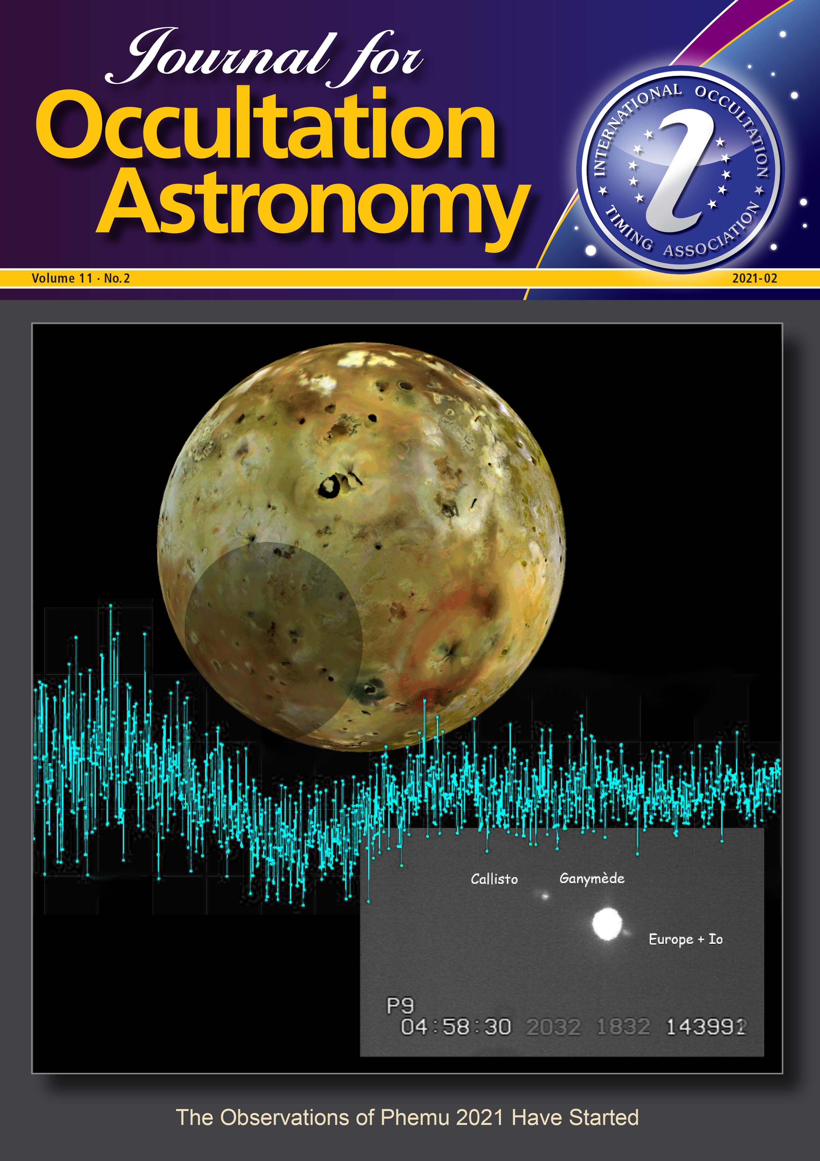
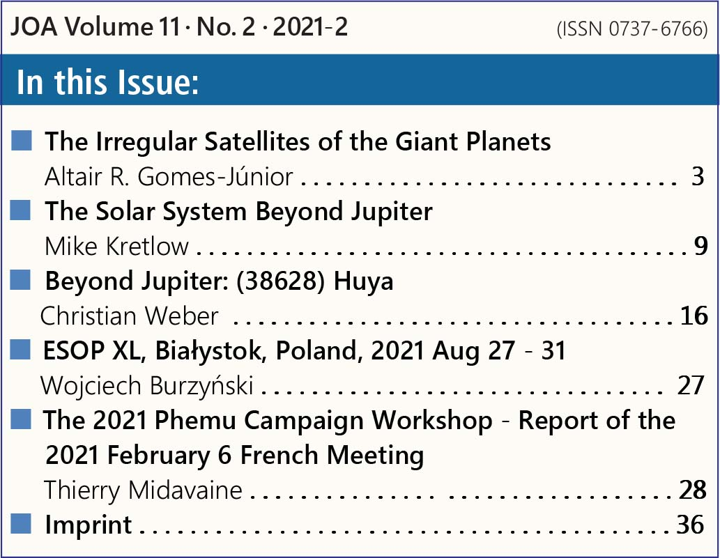
Journal for Occultation Astronomy
Journal by and for occultation observers of all capabilities and from all locations
Published quarterly
Freely available to all at https://iota-es.de/joafree.html

Slide 51
Software
Occult4 – lunar-occultations.com/iota/occult4.htm
Occultwatcher – www.occultwatcher.net
IOTA Video Capture/Video Playback – occultations.org/observing/software/
Pymovie / Pyote – occultations.org/observing/software/pymovie
Limovie – Astro-limovie-info/limovie/manual_0997/manual_en.html
Virtual Dub – www.virtualdub.org
Guide9 – not available via download, www.projectpluto.com
C2A – www.astrosurf.com/c2a/english
SharpCap – www.sharpcap.co.uk
Tangra – www.hristopavlov.net/tangra3/
Occurec – www.hristopavlov.net/OccuRec/OccuRec.htmo

Slide 52
IOTA’s Mission(s)
Provide predictions for occultations of stars by asteroids, planets, and the Moon
Encourage and facilitate the observation and measurement of occultations and eclipses
Provide software and information on observing equipment and techniques
Report to our members and publish our observations
Join us, won’t you?

